Slide 1
Library Assistants Network Meeting
19 March 2012
Term One
At Mother of Good Counsel, North Cairns

Slide 2
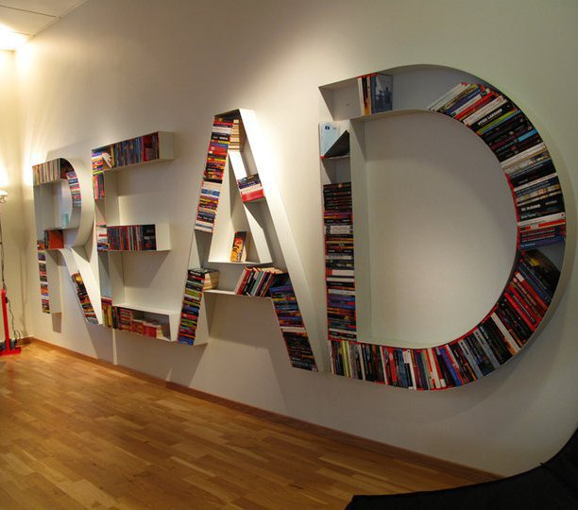
Agenda
National Year of Reading
Library Spaces Discussion
ebooks
Libcode:
CMEWeb Online Catalogue
Statistics
Magpies Subscription
Library Assistant Position Description
Qualification allowance /
Library certificate courses available
Digital Signage
Sources of free images for making signs, displays
Make and Take Session
Copied under Part VB
http://fab.com/inspiration/book-shelf

Slide 3
What is happening @ your library and school?
How is your school creating interest and hype about reading?
National Year of Reading
Notes:
Agenda for Library Assistant Meeting
19 March 2012
Mother of Good Counsel, North Cairns
394 Sheridan Street, Cairns North QLD 4870 (map)
National Year of Reading
Sharing events taking place in school libraries
What is working well in the new library spaces?
Feedback and sharing on how new library spaces are working.
What particular ideas are working well in at your school’s library e.g. new shelf markers & signage?
Professional Development : Using Statistics
Professional Development : Magpies Subscription
Demonstration : online database for sourcing literature for teachers around different topics and themes
Professional Development : Online Catalogues
Updating your CMEweb Catalogue
Library Assistant Position Description
Qualification allowance / Library certificate courses available
Digital Signage
Sources of free images for making signs, displays
Make and Take Session
Promotional tools for the school library - Book tags - 'book talker book marks'

Slide 4
NYOR You Tube Channel
National Year of Reading

Slide 5
Grandparents Day story time, classic picture stories (Devonshire tea)
High Tea in the Library
National Year of Reading
Copied under PartVB: “Afternoon Tea in the Library Bar”
http://www.fairmont.com/royalyork/GuestServices/Restaurants/AfternoonTea.htm
accessed 17 March 2012

Slide 6
National Year of Reading
Photo credit: CC by-nc-nd by Enokson

Slide 7
National Year of Reading
Photo credit: CC by-nc-nd by Enokson
http://www.flickr.com/photos/vblibrary/6877536033/sizes/m/in/photostream/

Slide 8
National Year of Reading
Photo credit: CC by-nc-nd by Enokson
http://www.flickr.com/photos/vblibrary/6876852747/sizes/m/in/photostream/

Slide 9
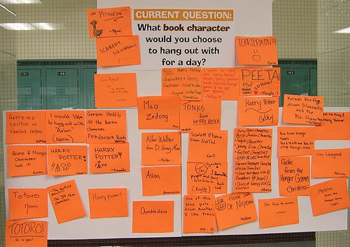
National Year of Reading
Photo credit: CC by-nc-nd by Enokson
http://www.flickr.com/photos/vblibrary/6829981078/in/set-72157629260379905

Slide 10
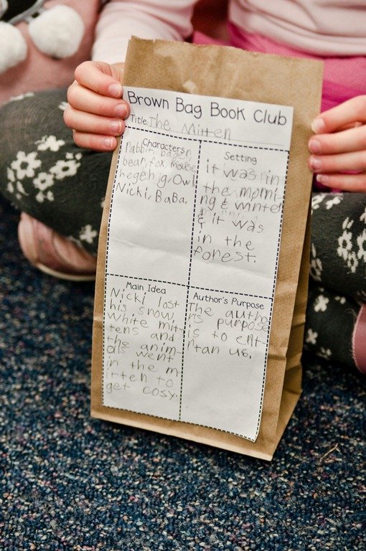
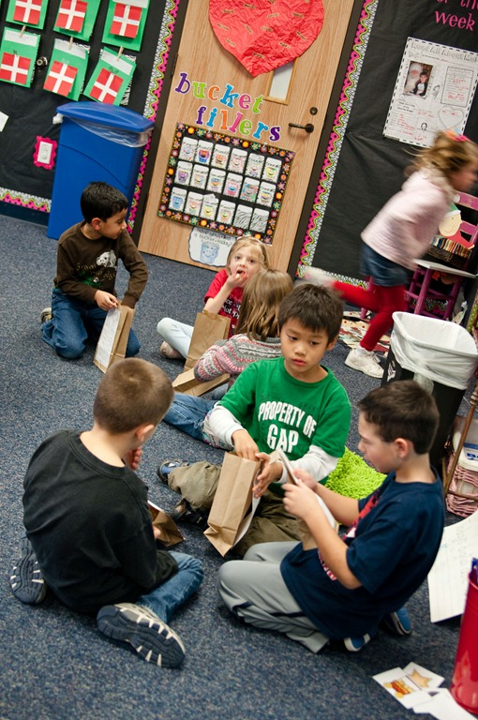
Brown Bag Book Club
National Year of Reading
Copied under Part VB: http://thefirstgradeparade.blogspot.com.au/search/label/Brown%20Bag%20Book%20Club
Notes:
Brown Bag Book Club meet every Friday afternoon.
Work with a teacher on this activity
Teacher would need to ok the template for the reading response
Read a book
Write a response
When complete bag is filled with popcorn
Discussion with others about the book.
Choose a story to read at the beginning of the week. This week, we read The Mitten. {We did a few whole group reader’s responses throughout the week…venn diagram, flow chart, story elements, etc.} At some point during the week, have the kids fill out a graphic organizer/thinking map and glue it to a brown paper bag {lunch sack}. I had my kids fill out a graphic organizer focusing on characters, setting, main idea, and author’s purpose. Any kind of graphic organizer/thinking map/response to reading will do!
The kids held on to their paper bags until this afternoon {Friday}. We ended up having an odd number of kids in the class today, so I grouped the kids into 3’s. We talked about book clubs and their purpose…the kids were SO on board! As I was passing out the popcorn for their bags, I had the kids talk to their groups about whether or not they liked the book, why, and what part of the book was their favorite. I heard some GOOD discussions!
Once they had their popcorn, Brown Bag Book Club was in session! I used these questions to guide discussion…

Slide 11
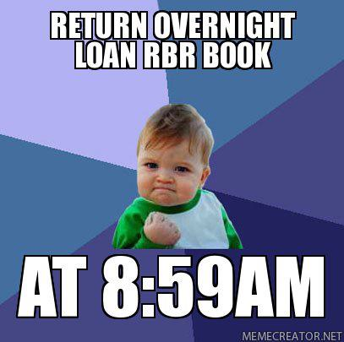
Create hype about new books
HOT SPEED READS
LATEST RELEASE
National Year of Reading
Photo creadti: Copied under Part VB
https://www.facebook.com/photo.php?fbid=10150635741594471&set=o.302465959802521&type=1&theater
Accessed 16 March, 2012

Slide 12
"Bad libraries build collections. Good libraries build services (of which a collection is only one). Great libraries build communities."
David Lankes
Library Spaces

Slide 13
Some of our
New School Libraries
Library Spaces
http://www.flickr.com/photos/60399258@N00/sets/

Slide 14
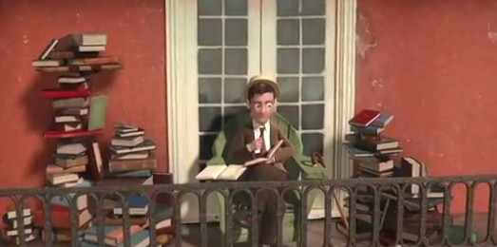
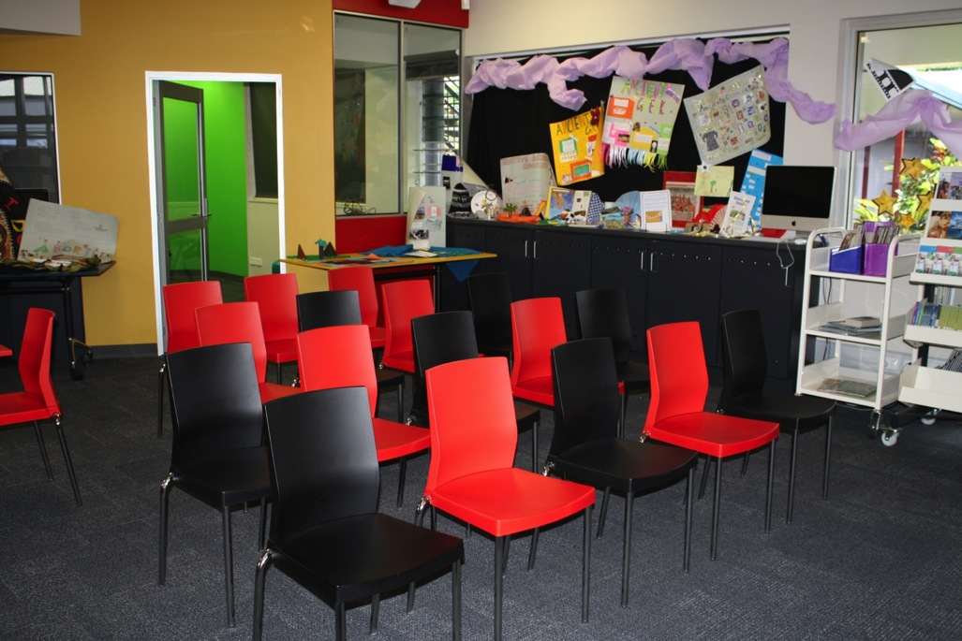
‪The Fantastic Flying Books of Mr. Morris Lessmore (2011)‬
Library Spaces
Oscar for the Best Animated Short Winner:
Photo: St Gerard Majella – flexible learning space

Slide 15
Magpies
Go to http://www.magpies.net.au/ and click on 'The Source'
Username : cescairns
Pasword: magpies
Australian and New Zealand Children’s Literature
Subject
annotations
Author
Themes in the book
Age group
Genre List
http://www.magpies.net.au/helpgenre.html

Slide 16
Library Assistant PD
Level 3 Position Description

Slide 17
Qualification Allowance
A school officer who has been on Level 3 Step 4 for twelve months (or 1976 hours for other than full time employees), and who holds a Certificate Level (IV) qualification (or higher) which is relevant to their work, and who holds a current First Aid certificate will receive the Qualification Allowance identified in Schedule 1 – Salary, Wages and Allowances.
(EB statement)
Further information

Slide 18
Creating displays … making signs
Some Ideas
http://www.flickr.com/photos/60399258@N00/favorites/page1/?view=md
http://www.kevinandamanda.com/fonts/

Slide 19
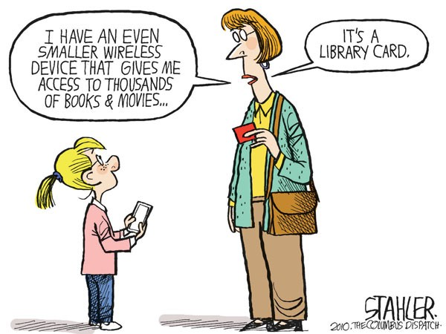
Ebooks ?
Cartoon Credit: Copied under Part VB
http://www.cagle.com/2010/09/jeff-stahlers-cartoon-for-9282010/

Slide 20
Read online: We Give Books
http://www.wegivebooks.org/
Notes:
160 ebooks that can be read online
Need to add an email address to complete donation
- Talk with IT technician about a generic account

Slide 21
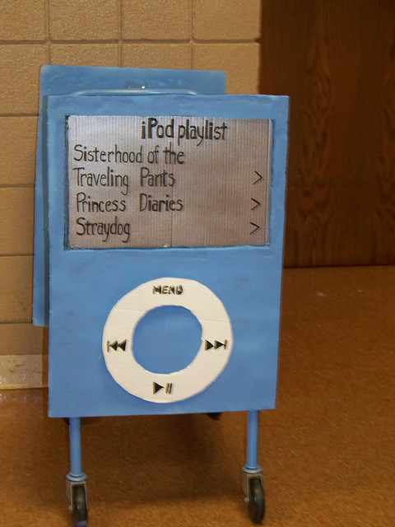
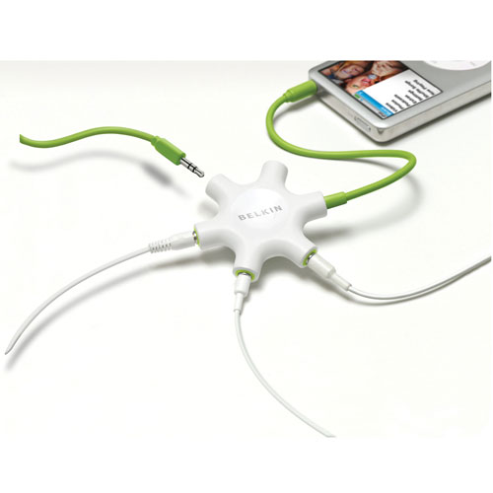
Audio Books
Will play on:-
Mp3 player
Ipods
Computer
Belkin Rockstar
Allows a number of students to
listen to a story
Photo Credit: CC BY NC ND Pioneer Library System
http://www.flickr.com/photos/jsyk/2759769357/in/faves-vblibrary/
Copied under Part VB
http://www.impulsegamer.com/hardware/rockstar3.jpg

Slide 22
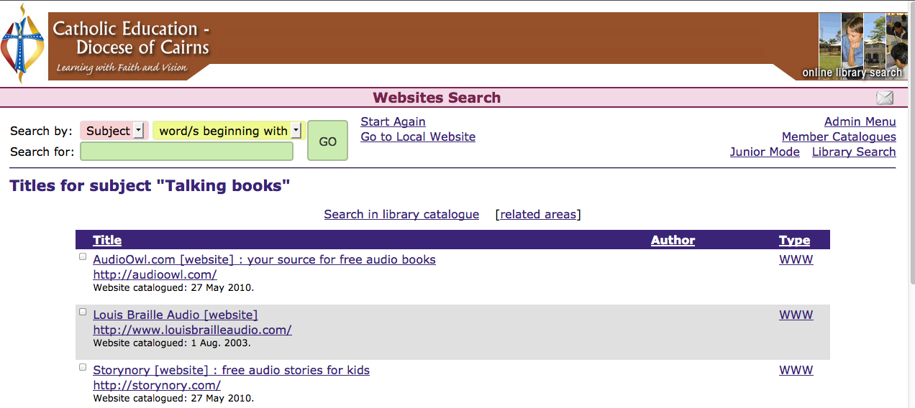
http://storynory.com
Search for subject heading ‘talking books’

Slide 23
Libcode Library Systems
New features of CMEweb
Statistics
School Library Statistics Instructions

Slide 24
Creative Commons Image Search
http://search.creativecommons.org/

Slide 25
Make and take
Make and Take Session
"Libraries: Cut apart these bookmarks and slip into books on display or on shelves, leaving them peeking out of the top of the pages or to attract attention to new books or books of specific genres. A black and white version is also available in my photo stream."
CC BY NC ND Enokson
http://www.flickr.com/photos/vblibrary/page40/

