Slide 1
Library Network Meeting for TLs & Teachers
27 March 2012
Term One
St Andrew’ s College, Redlynch

Slide 2
Agenda
9am Prayer - Debbie Mcguinnes
9.10 Introductions/ Apologies
9.20 HoverCam: Cross live to Classroom Teacher Jacinta Browning ( St Joseph’s Yr 7)
- Discuss use of Hovercam in classroom
Demonstration of various features of HoverCam (Fran Hughes)
Discussion re Library role in demonstration/ installation of new equipment
9.45 National Year of Reading - What’s Happening? Events/ Promotions
10.00 Readers Cup – Simone Gillies (TL @ St Stephens College), Verdi Reid (TL @ St Andrew's CC)
10.10 'Have you read?' Spotlighting Literature – Verdi Reid (TL @ St Andrew's CC) Magpies Database
10.20 School Library Association Conference Update – Gabrielle Anthony (TL @ St Andrews CC)
Notes:
Attendees: Virginia O’Dea (Host), Gabrielle Anthony, Verdi Reid, Jo Martorella, Debbie Mcguinnes, Alex England, Julie Lowry, Roberta Michna, Fran Hughes
Apologies: Christine Weedon, Chris Wright,

Slide 3
Agenda
11.00 ‘Who thinks the library is an absolute relic of the past?’ guest presenter Tony Ford
(Skype Conference)
12.00 ePlatform (Wheelers Books) – Demonstration of a platform that is available for lending of ebooks
http://www.wheelersbooks.com.au/info/ebooks
www.gotomeeting.com
12.45 LUNCH
1.30 Library Assistant PD Level 3 & work on revising Library Assistant PD Level 4 - Fran Hughes (CES)
2.00 Web 2.0 Spotlight
Diigo/ Delicious - Virginia O'Dea (Head of Information Services TL @ St Andrews)
Scoop IT – Fran Hughes (Catholic Education Services)
2.50 Evaluation / Wrap Up/ Next Meeting?

Slide 4
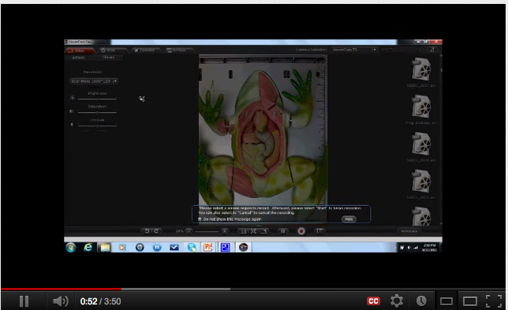
HoverCam Kudos
Features
2 cameras, allowing Picture-in-Picture recording and use as a webcam.
Communicatiing
Sharing
Demonstrating
Explaining
Close up
http://www.youtube.com/watch?v=dNzjT3pFnfU&feature=related
Notes:
Two cameras, allowing Picture-in-Picture recording and use as a webcam.
Patent pending smooth 8X digital zoom, and 1080P full motion HD video presentation and recording.
USB connection to computer for enhanced functionality requiring no power cable.
Drag-and-Drop scanned images with HoverCam Flex to an interactive whiteboard, PowerPoint, email and other compatible programs.
Featurs of Kudos 3
Create stack images and rearranging into a binder format
Create PDF files with scanned documents anytime
Drop and drop feature from scanned folders to any storage media, like flash drive, SD Card and online storage sites.
Comes with Hovercam Flex software that manages all files quickly and easily for editing, faxing and storing
Auto-trimming of dark edges of scanned documents
Auto-straightening of skewed and misaligned images during scanning
Auto-color adjustment and correction of scanned objects to achieve optimal brightness
HoverCam is an excellent classroom visual presentation tool. With fast and high resolution video, HoverCam is the most affordable and versatile document camera for educators. It can even double as a text book scanner for teachers.
Present: Use it with a projector in class to show live, large screen images of documents, worksheets or 3-D objects. The HoverCam’s 3-million or 5-million pixel camera provides clear images, even of small text. Use the Zoom function to show details.
Record a video: Both video and sound can be recording with a one click button and can be archived and shared via e-mail or a central learning platform for rehearsel purposes. HoverCam products are using high resolution 3 MP and 5 MP cameras in HD video.
Scanner: Each HoverCam is also a desktop scanner and can be used to scan graded exams, take pictures of texts in a book or 3-D objects etc. Educators can easily share the scanned materials with students/parents via e-mail or as archieved in a central learning platform.
Integration with Interactive Whiteboards: The Software support integration with interactive whitebowards such as Smart Notebook, Promethean ActivInspire, eBeam ActiveCapture, and Mimio Studio Notebook to show live video directly in the IWB software. Use the annotations tools in the IWB software to draw, write, measure etc. directly over the HoverCam video. Capture pictures or video with sound.
In PowerPoint: It can also be integrated into PowerPoint - show objects, texts etc directly in you PowerPoint presentation.
Distance learning: Use the camera togehter with communication services such as Skype, WebEx, GoToMeeting, or similar services providing screen sharing, to demonstrate or provide distance learning. Provides the function picture-in-picture i.e. show a video of yourself synced with what you show under the camera.
Compact design: Its compact design makes the HoverCam easy to carry. Use it on your desk, on a podium, or take it on the go. Only 900 gram and telescopic!

Slide 5
National Year of Reading
What is happening @ your library and school?
How is your school creating interest and hype about reading?
Notes:
Agenda for Library Assistant Meeting
19 March 2012
Mother of Good Counsel, North Cairns
394 Sheridan Street, Cairns North QLD 4870 (map)
National Year of Reading
Sharing events taking place in school libraries
What is working well in the new library spaces?
Feedback and sharing on how new library spaces are working.
What particular ideas are working well in at your school’s library e.g. new shelf markers & signage?
Professional Development : Using Statistics
Professional Development : Magpies Subscription
Demonstration : online database for sourcing literature for teachers around different topics and themes
Professional Development : Online Catalogues
Updating your CMEweb Catalogue
Library Assistant Position Description
Qualification allowance / Library certificate courses available
Digital Signage
Sources of free images for making signs, displays
Make and Take Session
Promotional tools for the school library - Book tags - 'book talker book marks'

Slide 6
NYOR You Tube Channel
National Year of Reading

Slide 7
http://stfdssc.twbceo.cmeweb.libcode.com.au/
Notes:
Petal taken for each month

Slide 8
Grandparents Day story time, classic picture stories (Devonshire tea)
High Tea in the Library
National Year of Reading
Copied under PartVB: “Afternoon Tea in the Library Bar”
http://www.fairmont.com/royalyork/GuestServices/Restaurants/AfternoonTea.htm
accessed 17 March 2012

Slide 9
National Year of Reading
Photo credit: CC by-nc-nd by Enokson

Slide 10
National Year of Reading
Photo credit: CC by-nc-nd by Enokson
http://www.flickr.com/photos/vblibrary/6877536033/sizes/m/in/photostream/

Slide 11
National Year of Reading
Photo credit: CC by-nc-nd by Enokson
http://www.flickr.com/photos/vblibrary/6876852747/sizes/m/in/photostream/

Slide 12
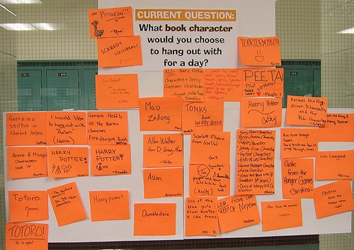
National Year of Reading
Photo credit: CC by-nc-nd by Enokson
http://www.flickr.com/photos/vblibrary/6829981078/in/set-72157629260379905

Slide 13
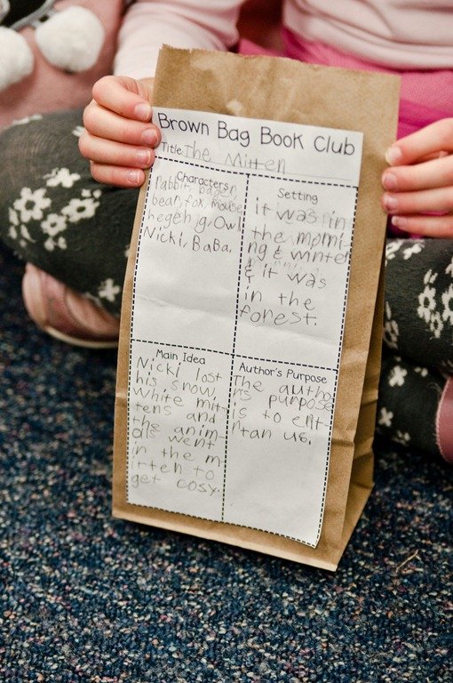
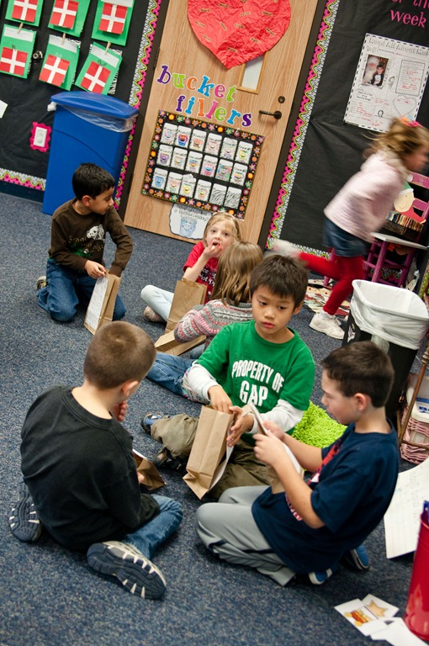
Brown Bag Book Club
National Year of Reading
Copied under Part VB: http://thefirstgradeparade.blogspot.com.au/search/label/Brown%20Bag%20Book%20Club
Notes:
Brown Bag Book Club meet every Friday afternoon.
Work with a teacher on this activity
Teacher would need to ok the template for the reading response
Read a book
Write a response
When complete bag is filled with popcorn
Discussion with others about the book.
Choose a story to read at the beginning of the week. This week, we read The Mitten. {We did a few whole group reader’s responses throughout the week…venn diagram, flow chart, story elements, etc.} At some point during the week, have the kids fill out a graphic organizer/thinking map and glue it to a brown paper bag {lunch sack}. I had my kids fill out a graphic organizer focusing on characters, setting, main idea, and author’s purpose. Any kind of graphic organizer/thinking map/response to reading will do!
The kids held on to their paper bags until this afternoon {Friday}. We ended up having an odd number of kids in the class today, so I grouped the kids into 3’s. We talked about book clubs and their purpose…the kids were SO on board! As I was passing out the popcorn for their bags, I had the kids talk to their groups about whether or not they liked the book, why, and what part of the book was their favorite. I heard some GOOD discussions!
Once they had their popcorn, Brown Bag Book Club was in session! I used these questions to guide discussion…

Slide 14
Magpies
Go to http://www.magpies.net.au/ and click on 'The Source'
Username : cescairns
Pasword: magpies
Australian and New Zealand Children’s Literature
Subject
annotations
Author
Themes in the book
Age group
Genre List
http://www.magpies.net.au/helpgenre.html

Slide 15
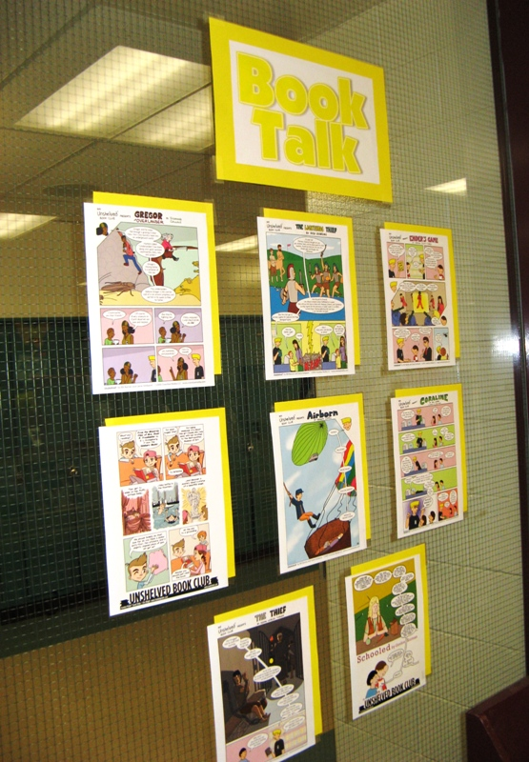
Comic Book Reviews : ‘Unshelved Book Club’
Some rights reserved by Enokson
http://www.flickr.com/photos/vblibrary/4605003418/in/set-72157624055234222/
Notes:
"Unshelved" cartoons (double-sided) about teen novels on the windows to the school hallway.

Slide 16
Creating displays … making signs
Some Ideas
http://www.flickr.com/photos/60399258@N00/favorites/page1/?view=md
http://www.kevinandamanda.com/fonts/

Slide 17
Library Assistant PD
Level 3 Position Description

Slide 18
Library Assistant PD
Employee in this position is required to demonstrate competency involving the application of knowledge with depth in some areas and a broad range of skills. There is a range of roles and tasks in a variety of contexts, where there is some complexity in the extent and choice of actions required. Competencies are within routines, methods and procedures. Some discretion and judgement are involved in selection of equipment, work organisation, services, actions and achieving outcomes within time constraints.
Work is performed under limited supervision and work may be checked in relation to overall progress. Work may take the form of broad guidance and may involve a level of autonomy when working in teams.
An employee in this positinon may have limited responsibility for guidance of the work of others. Peer assistance may be provided to others. Team co-ordination may be required.
Employee in this position is required to demonstrate competency involving the application of knowledge with depth in some areas and a broad range of skills. There is a range of roles and tasks in a variety of contexts, where there is some complexity in the ranges extent and choice of actions required. Competencies are within routines, methods and procedures. Discretion and judgement are required for self and/or others in planning of equipment, work, organisation, actions and achieving outcomes within time constraints.
Work is performed under general supervision. Progress and outcomes sought are under general guidance.
An employee in this position may have responsibility for the work and organisation of others in limited areas. The work of others may be supervised, teams may be guided or facilitated. Training of subordinate staff may be required.

Slide 19
Qualification Allowance
A school officer who has been on Level 3 Step 4 for twelve months (or 1976 hours for other than full time employees), and who holds a Certificate Level (IV) qualification (or higher) which is relevant to their work, and who holds a current First Aid certificate will receive the Qualification Allowance identified in Schedule 1 – Salary, Wages and Allowances.
(EB statement)
Further information

Slide 20
Libcode Library Systems
New features of CMEweb
Statistics
School Library Statistics Instructions

Slide 21
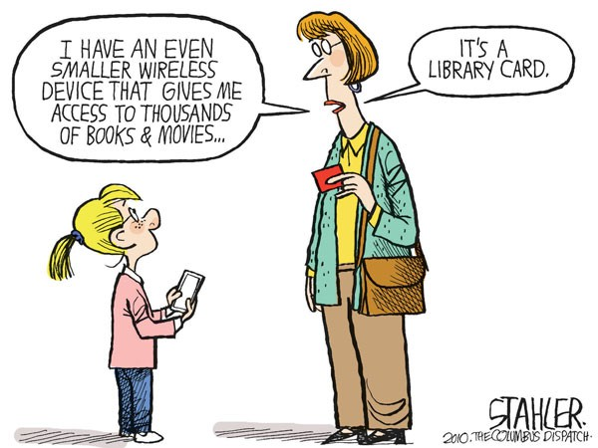
Ebooks ?
Cartoon Credit: Copied under Part VB
http://www.cagle.com/2010/09/jeff-stahlers-cartoon-for-9282010/

Slide 22
Read online: We Give Books
http://www.wegivebooks.org/
Notes:
160 ebooks that can be read online
Need to add an email address to complete donation
- Talk with IT technician about a generic account

Slide 23
Make and take
Make and Take Session
"Libraries: Cut apart these bookmarks and slip into books on display or on shelves, leaving them peeking out of the top of the pages or to attract attention to new books or books of specific genres. A black and white version is also available in my photo stream."
CC BY NC ND Enokson
http://www.flickr.com/photos/vblibrary/page40/

Slide 24
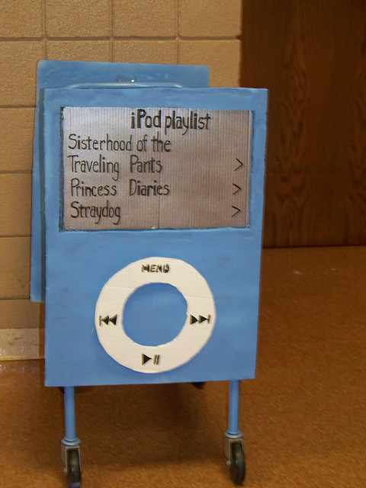
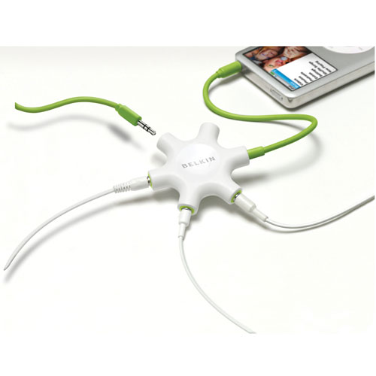
Audio Books
Will play on:-
Mp3 player
Ipods
Computer
Belkin Rockstar
Allows a number of students to
listen to a story
Photo Credit: CC BY NC ND Pioneer Library System
http://www.flickr.com/photos/jsyk/2759769357/in/faves-vblibrary/
Copied under Part VB
http://www.impulsegamer.com/hardware/rockstar3.jpg

Slide 25
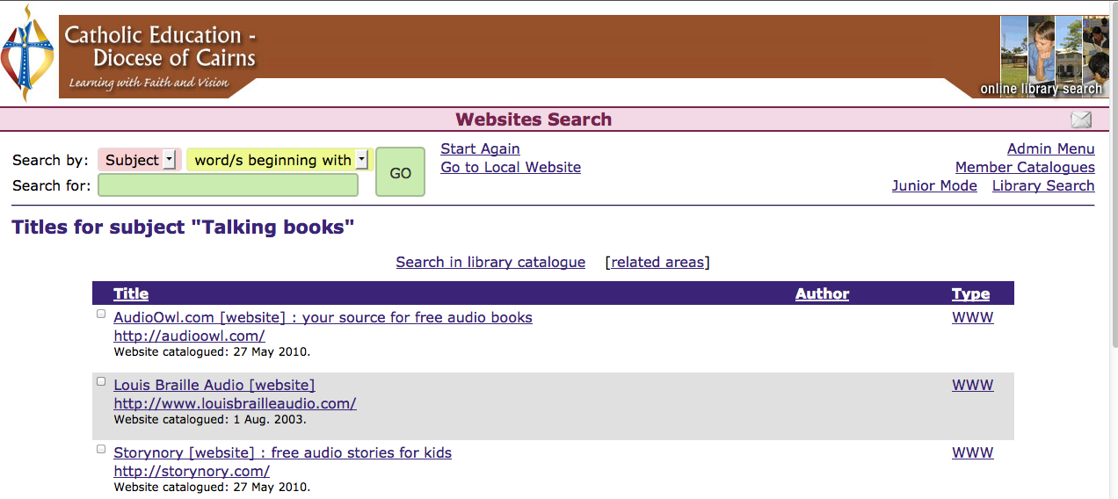
http://storynory.com
Search for subject heading ‘talking books’

Slide 26
Creative Commons Image Search
http://search.creativecommons.org/

Slide 27
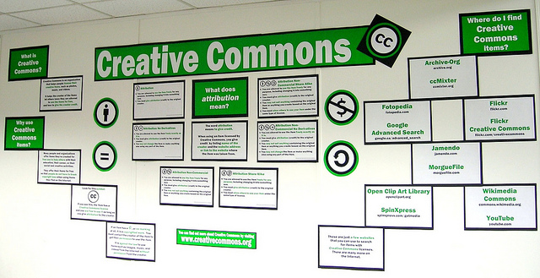
By NC SA by Enokson Creative Commons Bulletin Board http://www.flickr.com/photos/vblibrary/6842566312/in/photostream
http://www.flickr.com/photos/vblibrary/6842566312/in/photostream

Slide 28
16 & 17 April

Slide 29
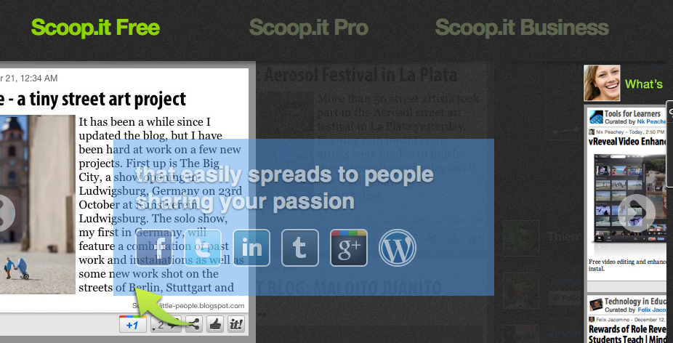
Scoop IT
http://www.scoop.it/pricing/guided-tour#Free

Slide 30
Scoop It
http://www.youtube.com/watch?v=Bnr6QKKcsII

Slide 31
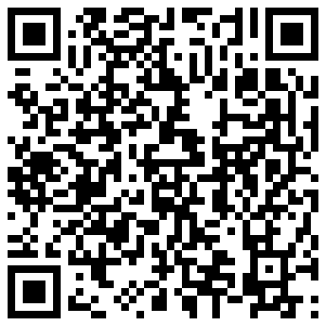
QR Codes
What are they?
How do you read them?
How are teacher librarians using them?
How do I make them?
Notes:
Quick response code – scannable – can lead you to text, audio or a website
1st used by toyota to track vehicles during manufacturing process http://mashable.com/follow/topics/qr-codes/http://mashable.com/follow/topics/qr-codes/

Slide 32
How are teacher librarians using them?
How do you deliver your library orientation lessons now?
“Our awesome ESOL kids were challenged to work in 2 teams to answer clues for a QR Code Quest! Lessons & worksheets can be found on my wiki - take, use, share!”
thedaringlibrarian.wikispaces.com/QR_Cod e_Quest
Notes:
Information conveyed via QR codes around the library.
QR code on card to keep for next year, wrote on the back of the card what it was.
IT staff added QR code reader to set of ipads
issued each pair of students with an iPad and a question sheet and sent them off on a treasure hunt, before debriefing them afterwards.

Slide 33
http://yourteacherlibrarian.wikispaces.com/Are+You+Ready?#tl-776a1a04

Slide 34
You are currently viewing 441b0_milwaukee-public-library from Marketing in the library at Hack Library School.

